Slide 1

Flawfinder – A Tool Analysis for Determining Security Weakness
Software Testing
Presentation for Exercise
Siddique Reza Khan
MSc in Cyber Security
Matrikel-Nr.:3846259
21.01.2019
Supervisor: Prof. Monika Heiner

Slide 2
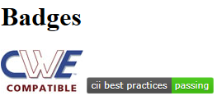
Introduction
A simple tool
Examines C/C++ source code
Reports possible security weaknesses (“flaws”) sorted by risk level
Very useful
Quickly finding and
Removing at least some potential security problems
Open source software(OSS)
Publically available to use
Flawfinder works on
GNU/Linux systems and
Windows by using Cygwin.
It requires Python 2.7 or Python 3 to run
Siddiqre Reza Khan, 3846259

Slide 3
Tool Comparison
Flawfinder:
Scans C/C++ code
Database of 128 C/C++ vulnerabilities.
Reporting warnings of 6 levels, form level 0 to 5,
ITS4: “It's The Software Stupid! Security Scanner”.
Scans C/C++ code
Database has 144 vulnerabilities.
6 levels of reporting warnings, level 0 to 5
RATS: “Rough Automatic Tool for Security”.
Scans C/C++, Python, PHP and Perl source code.
Rats has 3 levels of reporting warnings, Low, Medium and High
Siddiqre Reza Khan, 3846259

Slide 4
Downloading and Installing
The current version - 2.0.7
Linux-based system
First, download flawfinder in .tar.gz (tarball) format
https://dwheeler.com/flawfinder/flawfinder-2.0.7.tar.gz
Install
First, uncompress the file
Become root to install:
tar xvzf flawfinder-*.tar.gz
cd flawfinder-*
Then install we can do this (omit "sudo" if you are root)
1. sudo make prefix=/usr install
If you use Windows, the recommended way is to install Cygwin first, and install it on top of Cygwin.
Siddiqre Reza Khan, 3846259

Slide 5
Speed
Flawfinder is written in Python
Python code is not as fast as C code
Averaged analysis speed of 45,126 lines/second
OS - Linux kernel
CPU - Intel Core 2 Duo CPU E8400
Speed - 3.00GHz (each CPU running at 2GHz)
Averaged 24,475 lines/second
OS – Windows
Environment - 2.8GHz laptop and Cygwin
Cygwin on Windows tends to be much slower than Linux
Siddiqre Reza Khan, 3846259
Notes:
, to simplify the task of writing and extending it.
The speed reported begins when the program starts running, not including the fixed Python start-up time.

Slide 6
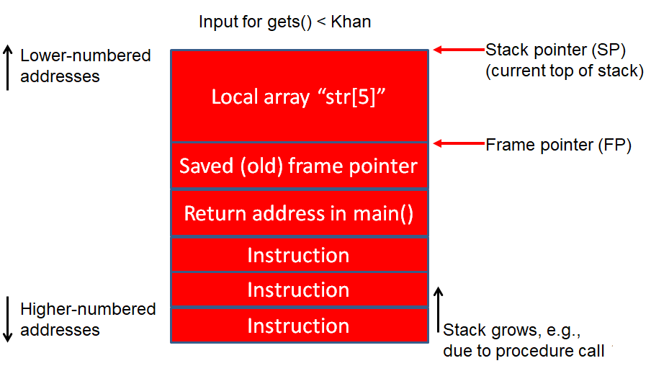
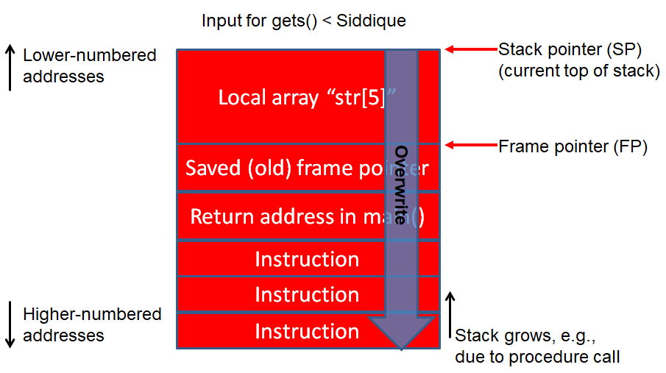
Buffer Overflow Risk
Programmer
Attacker
Program crash:
Enter a value: Siddique
Segmentation Fault
Correct output:
Enter a value : Khan
You entered: Khan
Siddiqre Reza Khan, 3846259
Notes:
C Programming Language Video Tutorials for Beginners ( COMPLETE SERIES )
LearningLad1 / 178
45, 51, 52, 53, 9, 10, 65, 66, 105,
Flawfinder is not a sophisticated tool. It is an intentionally simple tool, but people have found it useful.
Flawfinder works by using a built-in database of C/C++ functions with well-known problems, such as buffer overflow risks (e.g., strcpy(), strcat(), gets(), sprintf(), and the scanf() family), format string problems ([v][f]printf(), [v]snprintf(), and syslog()), race conditions (such as access(), chown(), chgrp(), chmod(), tmpfile(), tmpnam(), tempnam(), and mktemp()), potential shell metacharacter dangers (most of the exec() family, system(), popen()), and poor random number acquisition (such as random()). The good thing is that you don’t have to create this database - it comes with the tool.
Flawfinder then takes the source code text, and matches the source code text against those names, while ignoring text inside comments and strings (except for flawfinder directives). Flawfinder also knows about gettext (a common library for internationalized programs), and will treat constant strings passed through gettext as though they were constant strings; this reduces the number of false hits in internationalized programs.
Flawfinder produces a list of “hits” (potential security flaws), sorted by risk; by default the riskiest hits are shown first. This risk level depends not only on the function, but on the values of the parameters of the function. For example, constant strings are often less risky than fully variable strings in many contexts. In some cases, flawfinder may be able to determine that the construct isn’t risky at all, reducing false positives.

Slide 7
How does Flawfinder Work?(Cont. 1/2)
Programmer
Attacker
/** Vulnerable Program */
#include <stdio.h>
//statements
void getName()
{ char str[5];
printf( "Enter your name :");
gets( str );
printf( "\nYou entered: ");
puts( str );
}
int main( )
{
//Statements
getName() /** Function Call */
//Statements
return 0;
}
Flawfinder Tool
/** Database*/
/** C library functions considered Harmful */
strcpy() // Buffer overflow risks
strcat() // Buffer overflow risks
gets() // Buffer overflow risks
sprintf() // Buffer overflow risks
scanf() // Buffer overflow risks
printf() // Format string problems
snprintf() // Format string problems
system() // shell metacharacter dangers
popen()// shell metacharacter dangers
/** Database of 128 C/C++ vulnerabilities */
Match found
by Lexical
Analysis,
so, 1 hit
Program crash:
Enter a value: Siddique
Segmentation Fault
Program crash:
Enter a value: Siddique
Segmentation Fault
Correct output:
Enter a value : Khan
You entered: Khan
Siddiqre Reza Khan, 3846259
Notes:
C Programming Language Video Tutorials for Beginners ( COMPLETE SERIES )
LearningLad1 / 178
45, 51, 52, 53, 9, 10, 65, 66, 105,
Flawfinder is not a sophisticated tool. It is an intentionally simple tool, but people have found it useful.
Flawfinder works by using a built-in database of C/C++ functions with well-known problems, such as buffer overflow risks (e.g., strcpy(), strcat(), gets(), sprintf(), and the scanf() family), format string problems ([v][f]printf(), [v]snprintf(), and syslog()), race conditions (such as access(), chown(), chgrp(), chmod(), tmpfile(), tmpnam(), tempnam(), and mktemp()), potential shell metacharacter dangers (most of the exec() family, system(), popen()), and poor random number acquisition (such as random()). The good thing is that you don’t have to create this database - it comes with the tool.
Flawfinder then takes the source code text, and matches the source code text against those names, while ignoring text inside comments and strings (except for flawfinder directives). Flawfinder also knows about gettext (a common library for internationalized programs), and will treat constant strings passed through gettext as though they were constant strings; this reduces the number of false hits in internationalized programs.
Flawfinder produces a list of “hits” (potential security flaws), sorted by risk; by default the riskiest hits are shown first. This risk level depends not only on the function, but on the values of the parameters of the function. For example, constant strings are often less risky than fully variable strings in many contexts. In some cases, flawfinder may be able to determine that the construct isn’t risky at all, reducing false positives.

Slide 8
How does Flawfinder Work?(cont. 2/2)
Analyze software C/C++ ﬁlename extensions
Needn't build in some cases and even locally compile
Physical source lines of code (SLOC) analyzed
Built-in database of C/C++ functions
Matches the source code against names of library function
Ignoring text inside comments except for flawfinder directives
// Flawﬁnder: ignore or /* Flawﬁnder: ignore */
Produces a list of “hits” sorted by risk,
Example "[0] 0[1] 9" means, at level 0 total 0 hits reported, and at level 1 total 9 hits reported; level 3+ has the sum of the number of hits at level 3, 4, and 5; KSLOC is each "level or higher" values multiplied by 1000 and divided by the physical SLOC
Siddiqre Reza Khan, 3846259
Notes:
common library for internationalized programs
Flawﬁnder is ofﬁcially CWE-Compatible. Hit descriptions with
"[MS-banned]" indicate functions that are in the banned list of functions released by Microsoft; see
http://msdn.microsoft.com/en-us/library/bb288454.aspx for more information about banned functions.

Slide 9
Built-in database
Built-in database of C/C++ functions
Buffer overflow risks (e.g., strcpy(), strcat(), gets(), sprintf(), and the scanf() family),
Format string problems (printf(), snprintf(), and syslog()),
Race conditions (such as access(), chown(), chgrp(), chmod(), tmpfile(), tmpnam(), tempnam(), and mktemp()),
Potential shell metacharacter dangers (most of the exec() family, system(), popen()), and
Poor random number acquisition (such as random())
Siddiqre Reza Khan, 3846259
Notes:
C Programming Language Video Tutorials for Beginners ( COMPLETE SERIES )
LearningLad1 / 178
45, 51, 52, 53, 9, 10, 65, 66, 105,
Flawfinder is not a sophisticated tool. It is an intentionally simple tool, but people have found it useful.
Flawfinder works by using a built-in database of C/C++ functions with well-known problems, such as buffer overflow risks (e.g., strcpy(), strcat(), gets(), sprintf(), and the scanf() family), format string problems ([v][f]printf(), [v]snprintf(), and syslog()), race conditions (such as access(), chown(), chgrp(), chmod(), tmpfile(), tmpnam(), tempnam(), and mktemp()), potential shell metacharacter dangers (most of the exec() family, system(), popen()), and poor random number acquisition (such as random()). The good thing is that you don’t have to create this database - it comes with the tool.
Flawfinder then takes the source code text, and matches the source code text against those names, while ignoring text inside comments and strings (except for flawfinder directives). Flawfinder also knows about gettext (a common library for internationalized programs), and will treat constant strings passed through gettext as though they were constant strings; this reduces the number of false hits in internationalized programs.
Flawfinder produces a list of “hits” (potential security flaws), sorted by risk; by default the riskiest hits are shown first. This risk level depends not only on the function, but on the values of the parameters of the function. For example, constant strings are often less risky than fully variable strings in many contexts. In some cases, flawfinder may be able to determine that the construct isn’t risky at all, reducing false positives.

Slide 10
False Positive
During audited a program
Can mark source code lines that are actually ﬁne but cause false warnings
Fundamentally a naive program
Doesn’t know about the data types of function parameters
Doesn’t do control flow or data flow analysis
Important reminders:
Not every hit is necessarily a security vulnerability
There may be other security vulnerabilities not reported by the tool.
Siddiqre Reza Khan, 3846259

Slide 11
Flawfinder Options
Number of command line options
Grouped into options
Control its own documentation
Select which hits to display
Select the output format, and
Perform hit list management
Flawﬁnder can identify a program input in command line
ﬂawﬁnder TestProgram.c|less
Long option arguments
Provided as ‘‘--name=value’’ or ‘‘-name value’’.
Siddiqre Reza Khan, 3846259

Slide 12
Options : Documentation (Cont. 1/4 )
−−help or −h
Show usage (help) information.
−−version
Shows (just) the version number and exits.
−−listrules
List the terms (tokens) that trigger further examination
Default risk level, and
Default warning (including the CWE identiﬁer(s), if applicable), all tab-separated.
Called potentially-dangerous functions.
Siddiqre Reza Khan, 3846259

Slide 13
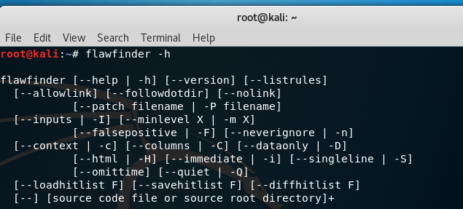
Options : Documentation (Cont. 2/4 )
Show usage (help) information
root@kali:~# flawfinder -h
Siddiqre Reza Khan, 3846259

Slide 14

Options : Documentation (Cont. 3/4 )
Shows (just) the version number and exits.
root@kali:~# flawfinder --version
Siddiqre Reza Khan, 3846259

Slide 15
Options : Documentation (Cont. 4/4 )
List the terms (tokens) that trigger further examination
root@kali:~# flawfinder --listrules
Siddiqre Reza Khan, 3846259

Slide 16
Options : Hits to Display (Cont. 1/6)
−−inputs or −I
Show only functions that obtain data from outside the program
−−minlevel=X or -m X
Set minimum risk level to X for inclusion in hit list
−−falsepositive or −F
Do not include hits that are likely to be false positives.
−−neverignore or -n
Never ignore security issues, even if they have an ‘‘ignore’’ directive in a comment
−−regexp=PATTERN or -e PATTERN
Only report hits with text that matches the regular expression pattern PATTERN
Siddiqre Reza Khan, 3846259

Slide 17
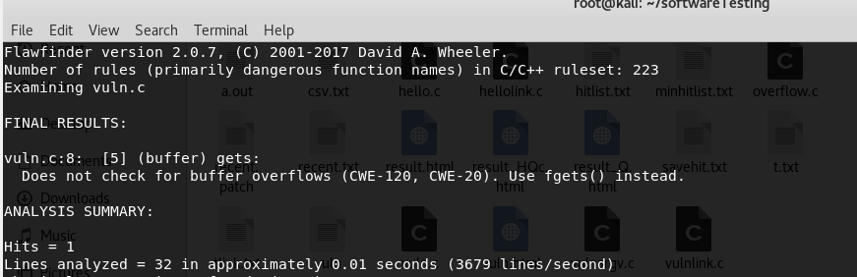
Options : Hits to Display (Cont. 2/6)
Show only functions that obtain data from outside the program
root@kali:~# flawfinder -I vuln.c| less
Siddiqre Reza Khan, 3846259

Slide 18
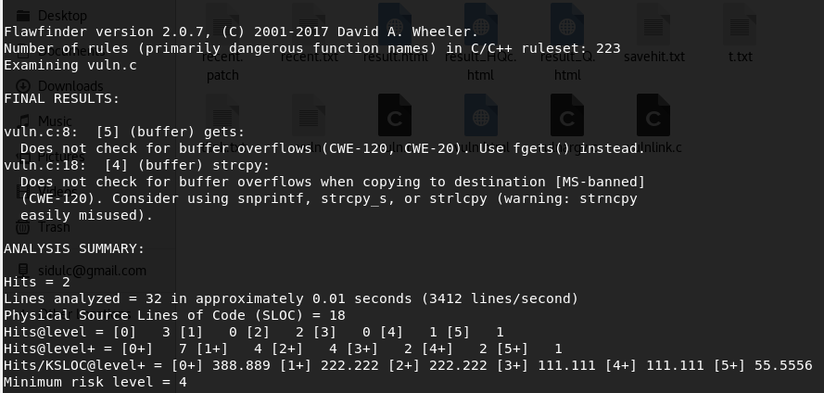
Options : Hits to Display (Cont. 3/6)
Set minimum risk level to X for inclusion in hit list
root@kali:~# flawfinder -m 4 vuln.c | less
Siddiqre Reza Khan, 3846259

Slide 19
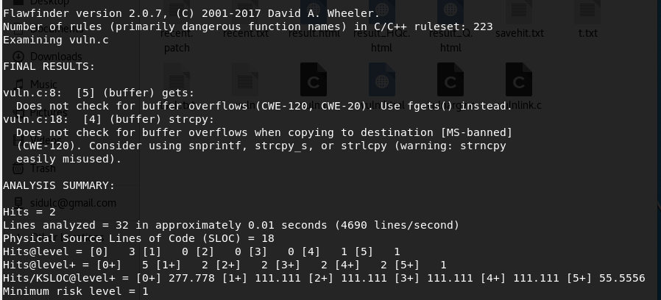
Options : Hits to Display (Cont. 4/6)
Do not include hits that are likely to be false positives
root@kali:~# flawfinder -F vuln.c | less
Siddiqre Reza Khan, 3846259

Slide 20
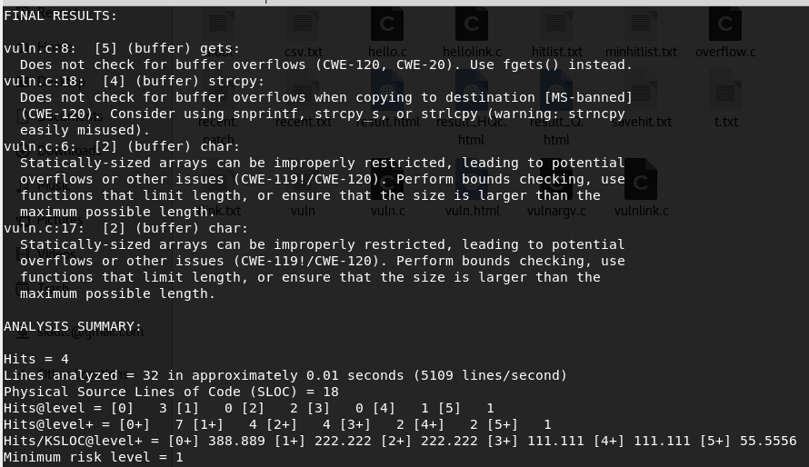
Options : Hits to Display (Cont. 5/6)
Never ignore security issues, even if they have an ‘‘ignore’’ directive in a comment
root@kali:~# flawfinder -n vuln.c | less
Siddiqre Reza Khan, 3846259

Slide 21
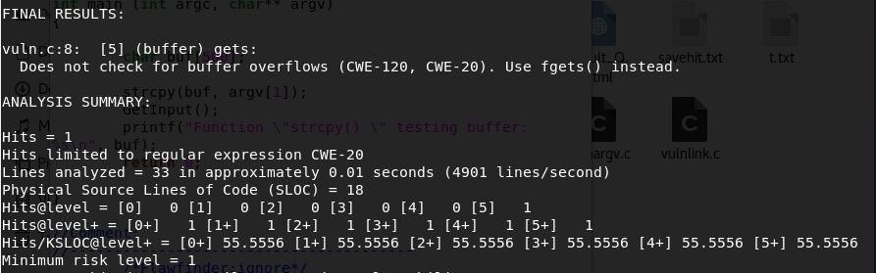
Options : Hits to Display (Cont. 6/6)
Only report hits with text that matches the regular expression pattern PATTERN
root@kali:~/softwareTesting# flawfinder -e CWE-20 vuln.c | less
Siddiqre Reza Khan, 3846259

Slide 22
Options : Output Format (Cont. 1/4)
−−columns or −C
Show the column number (as well as the ﬁle name and line number) of each hit;
−−context or −c
Show context, i.e., the line having the "hit"/potential ﬂaw. By default the line is shown immediately after the warning.
−−csv
Generate output in comma-separated-value (CSV) format.
This is the recommended format for sending to other tools for processing
Siddiqre Reza Khan, 3846259
Notes:
this is shown after the line number by adding a colon and the column number in the line (the ﬁrst character in a line is column number 1). This is useful for editors that can jump to speciﬁc columns, or for integrating with other tools (such as those to further ﬁlter out false positives).
This is the recommended format for sending to other tools for processing. It will always generate a header row, followed by 0 or more data rows (one data rowfor each hit).
The headers are mostly self-explanatory."File" is the ﬁlename, "Line" is the line number,"Column" is the column (starting from 1), "Level" is the risk level (0-5, 5 is riskiest), "Category" is the general ﬂawﬁnder category,"Name" is the name of the triggering rule, "Warning" is text explaining why it is a hit (ﬁnding), "Suggestion" is text suggesting how it might be ﬁxed, "Note" is other explanatory notes, "CWEs" is the list of one or more CWEs, "Context" is the source code line triggering the hit, and "Fingerprint" is the SHA-256 hash of the context once its leading and trailing whitespace have been removed (the ﬁngerprint may help detect and eliminate later duplications). If you use Python3, the hash is of the context when encoded as UTF-8.

Slide 23
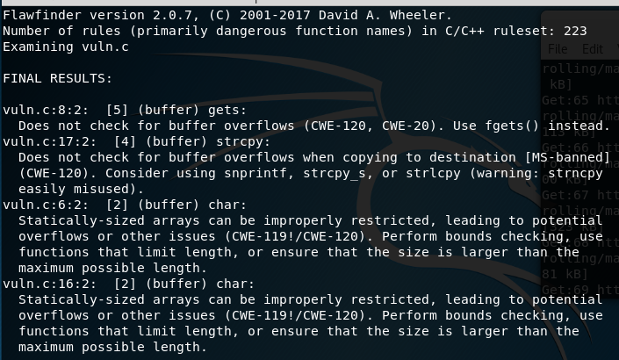
Options : Output Format (Cont. 2/4)
Show the column number (as well as the ﬁle name and line number) of each hit
root@kali:~/softwareTesting# flawfinder -C vuln.c|less
Siddiqre Reza Khan, 3846259
Notes:
this is shown after the line number by adding a colon and the column number in the line (the ﬁrst character in a line is column number 1). This is useful for editors that can jump to speciﬁc columns, or for integrating with other tools (such as those to further ﬁlter out false positives).
This is the recommended format for sending to other tools for processing. It will always generate a header row, followed by 0 or more data rows (one data rowfor each hit).
The headers are mostly self-explanatory."File" is the ﬁlename, "Line" is the line number,"Column" is the column (starting from 1), "Level" is the risk level (0-5, 5 is riskiest), "Category" is the general ﬂawﬁnder category,"Name" is the name of the triggering rule, "Warning" is text explaining why it is a hit (ﬁnding), "Suggestion" is text suggesting how it might be ﬁxed, "Note" is other explanatory notes, "CWEs" is the list of one or more CWEs, "Context" is the source code line triggering the hit, and "Fingerprint" is the SHA-256 hash of the context once its leading and trailing whitespace have been removed (the ﬁngerprint may help detect and eliminate later duplications). If you use Python3, the hash is of the context when encoded as UTF-8.

Slide 24
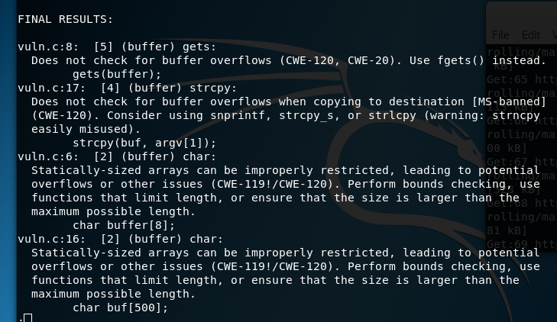
Options : Output Format (Cont. 3/4)
Show context, i.e., the line having the "hit"/potential ﬂaw. By default the line is shown immediately after the warning.
root@kali:~/softwareTesting# flawfinder -c vuln.c|less
Siddiqre Reza Khan, 3846259
Notes:
this is shown after the line number by adding a colon and the column number in the line (the ﬁrst character in a line is column number 1). This is useful for editors that can jump to speciﬁc columns, or for integrating with other tools (such as those to further ﬁlter out false positives).
This is the recommended format for sending to other tools for processing. It will always generate a header row, followed by 0 or more data rows (one data rowfor each hit).
The headers are mostly self-explanatory."File" is the ﬁlename, "Line" is the line number,"Column" is the column (starting from 1), "Level" is the risk level (0-5, 5 is riskiest), "Category" is the general ﬂawﬁnder category,"Name" is the name of the triggering rule, "Warning" is text explaining why it is a hit (ﬁnding), "Suggestion" is text suggesting how it might be ﬁxed, "Note" is other explanatory notes, "CWEs" is the list of one or more CWEs, "Context" is the source code line triggering the hit, and "Fingerprint" is the SHA-256 hash of the context once its leading and trailing whitespace have been removed (the ﬁngerprint may help detect and eliminate later duplications). If you use Python3, the hash is of the context when encoded as UTF-8.

Slide 25
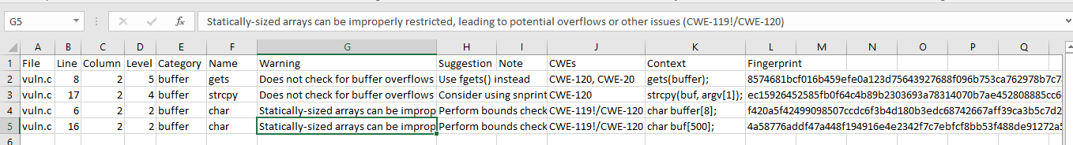
Options : Output Format (Cont. 4/4)
Generate output in comma-separated-value (CSV) format.
flawfinder --csv vuln.c >data.csv
Siddiqre Reza Khan, 3846259
Notes:
this is shown after the line number by adding a colon and the column number in the line (the ﬁrst character in a line is column number 1). This is useful for editors that can jump to speciﬁc columns, or for integrating with other tools (such as those to further ﬁlter out false positives).
This is the recommended format for sending to other tools for processing. It will always generate a header row, followed by 0 or more data rows (one data rowfor each hit).
The headers are mostly self-explanatory."File" is the ﬁlename, "Line" is the line number,"Column" is the column (starting from 1), "Level" is the risk level (0-5, 5 is riskiest), "Category" is the general ﬂawﬁnder category,"Name" is the name of the triggering rule, "Warning" is text explaining why it is a hit (ﬁnding), "Suggestion" is text suggesting how it might be ﬁxed, "Note" is other explanatory notes, "CWEs" is the list of one or more CWEs, "Context" is the source code line triggering the hit, and "Fingerprint" is the SHA-256 hash of the context once its leading and trailing whitespace have been removed (the ﬁngerprint may help detect and eliminate later duplications). If you use Python3, the hash is of the context when encoded as UTF-8.

Slide 26
Options : Output Format (Cont. 1/7)
−D
Don’t display the header and footer.
−−html or −H
Format the output as HTML instead of as simple text.
−−immediate or -i
Immediately display hits (don’t just wait until the end).
−−singleline or -S
Display as single line of text output for each hit.
−−omittime
Omit timing information.
−−quiet or −Q
Don’t display which ﬁles are being examined
Siddiqre Reza Khan, 3846259
Notes:
this is shown after the line number by adding a colon and the column number in the line (the ﬁrst character in a line is column number 1). This is useful for editors that can jump to speciﬁc columns, or for integrating with other tools (such as those to further ﬁlter out false positives).
This is the recommended format for sending to other tools for processing. It will always generate a header row, followed by 0 or more data rows (one data rowfor each hit).
The headers are mostly self-explanatory."File" is the ﬁlename, "Line" is the line number,"Column" is the column (starting from 1), "Level" is the risk level (0-5, 5 is riskiest), "Category" is the general ﬂawﬁnder category,"Name" is the name of the triggering rule, "Warning" is text explaining why it is a hit (ﬁnding), "Suggestion" is text suggesting how it might be ﬁxed, "Note" is other explanatory notes, "CWEs" is the list of one or more CWEs, "Context" is the source code line triggering the hit, and "Fingerprint" is the SHA-256 hash of the context once its leading and trailing whitespace have been removed (the ﬁngerprint may help detect and eliminate later duplications). If you use Python3, the hash is of the context when encoded as UTF-8.

Slide 27
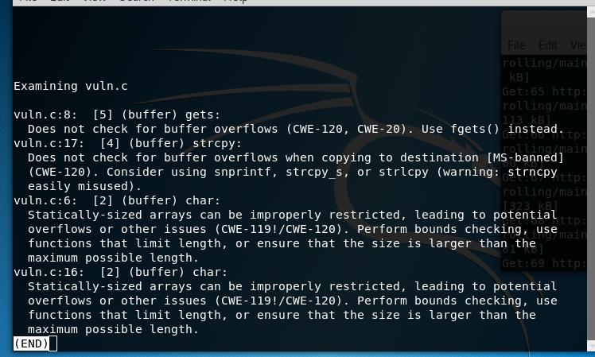
Options : Output Format (Cont. 2/7)
Don’t display the header and footer.
root@kali:~/softwareTesting# flawfinder -D vuln.c|less
Siddiqre Reza Khan, 3846259
Notes:
this is shown after the line number by adding a colon and the column number in the line (the ﬁrst character in a line is column number 1). This is useful for editors that can jump to speciﬁc columns, or for integrating with other tools (such as those to further ﬁlter out false positives).
This is the recommended format for sending to other tools for processing. It will always generate a header row, followed by 0 or more data rows (one data rowfor each hit).
The headers are mostly self-explanatory."File" is the ﬁlename, "Line" is the line number,"Column" is the column (starting from 1), "Level" is the risk level (0-5, 5 is riskiest), "Category" is the general ﬂawﬁnder category,"Name" is the name of the triggering rule, "Warning" is text explaining why it is a hit (ﬁnding), "Suggestion" is text suggesting how it might be ﬁxed, "Note" is other explanatory notes, "CWEs" is the list of one or more CWEs, "Context" is the source code line triggering the hit, and "Fingerprint" is the SHA-256 hash of the context once its leading and trailing whitespace have been removed (the ﬁngerprint may help detect and eliminate later duplications). If you use Python3, the hash is of the context when encoded as UTF-8.

Slide 28
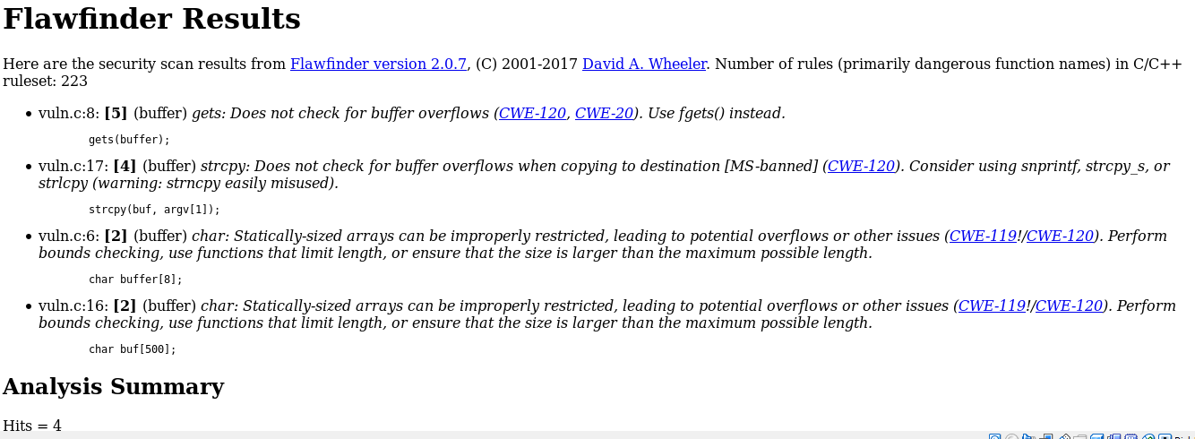
Options : Output Format (Cont. 3/7)
Format the output as HTML instead of as simple text.
root@kali:~/softwareTesting# flawfinder -H vuln.c>vuln1.html
Siddiqre Reza Khan, 3846259
Notes:
this is shown after the line number by adding a colon and the column number in the line (the ﬁrst character in a line is column number 1). This is useful for editors that can jump to speciﬁc columns, or for integrating with other tools (such as those to further ﬁlter out false positives).
This is the recommended format for sending to other tools for processing. It will always generate a header row, followed by 0 or more data rows (one data rowfor each hit).
The headers are mostly self-explanatory."File" is the ﬁlename, "Line" is the line number,"Column" is the column (starting from 1), "Level" is the risk level (0-5, 5 is riskiest), "Category" is the general ﬂawﬁnder category,"Name" is the name of the triggering rule, "Warning" is text explaining why it is a hit (ﬁnding), "Suggestion" is text suggesting how it might be ﬁxed, "Note" is other explanatory notes, "CWEs" is the list of one or more CWEs, "Context" is the source code line triggering the hit, and "Fingerprint" is the SHA-256 hash of the context once its leading and trailing whitespace have been removed (the ﬁngerprint may help detect and eliminate later duplications). If you use Python3, the hash is of the context when encoded as UTF-8.

Slide 29
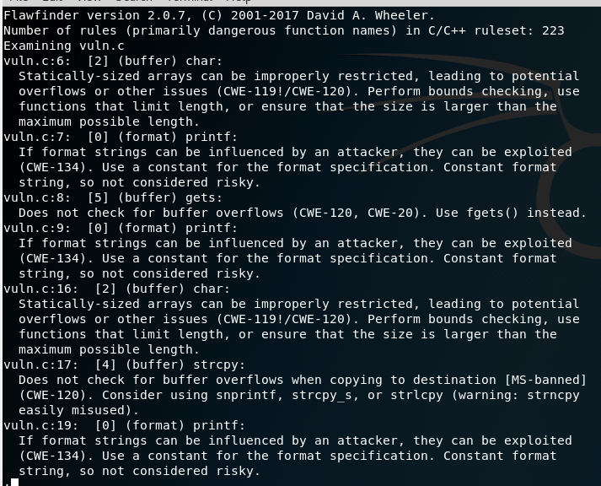
Options : Output Format (Cont. 4/7)
Immediately display hits
root@kali:~/softwareTesting# flawfinder -i vuln.c|less
Siddiqre Reza Khan, 3846259
Notes:
this is shown after the line number by adding a colon and the column number in the line (the ﬁrst character in a line is column number 1). This is useful for editors that can jump to speciﬁc columns, or for integrating with other tools (such as those to further ﬁlter out false positives).
This is the recommended format for sending to other tools for processing. It will always generate a header row, followed by 0 or more data rows (one data rowfor each hit).
The headers are mostly self-explanatory."File" is the ﬁlename, "Line" is the line number,"Column" is the column (starting from 1), "Level" is the risk level (0-5, 5 is riskiest), "Category" is the general ﬂawﬁnder category,"Name" is the name of the triggering rule, "Warning" is text explaining why it is a hit (ﬁnding), "Suggestion" is text suggesting how it might be ﬁxed, "Note" is other explanatory notes, "CWEs" is the list of one or more CWEs, "Context" is the source code line triggering the hit, and "Fingerprint" is the SHA-256 hash of the context once its leading and trailing whitespace have been removed (the ﬁngerprint may help detect and eliminate later duplications). If you use Python3, the hash is of the context when encoded as UTF-8.

Slide 30
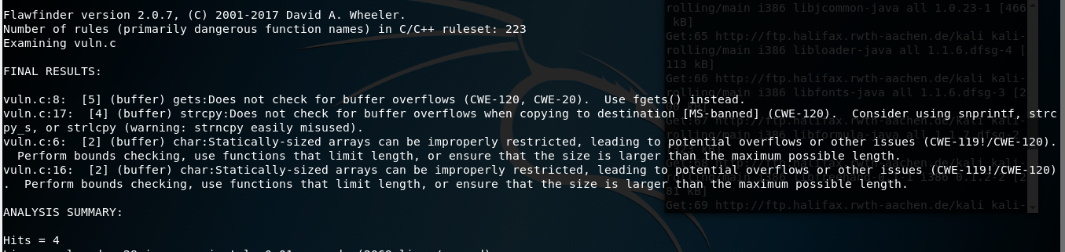
Options : Output Format (Cont. 5/7)
Display as single line of text output for each hit.
root@kali:~/softwareTesting# flawfinder -S vuln.c|less
Siddiqre Reza Khan, 3846259
Notes:
this is shown after the line number by adding a colon and the column number in the line (the ﬁrst character in a line is column number 1). This is useful for editors that can jump to speciﬁc columns, or for integrating with other tools (such as those to further ﬁlter out false positives).
This is the recommended format for sending to other tools for processing. It will always generate a header row, followed by 0 or more data rows (one data rowfor each hit).
The headers are mostly self-explanatory."File" is the ﬁlename, "Line" is the line number,"Column" is the column (starting from 1), "Level" is the risk level (0-5, 5 is riskiest), "Category" is the general ﬂawﬁnder category,"Name" is the name of the triggering rule, "Warning" is text explaining why it is a hit (ﬁnding), "Suggestion" is text suggesting how it might be ﬁxed, "Note" is other explanatory notes, "CWEs" is the list of one or more CWEs, "Context" is the source code line triggering the hit, and "Fingerprint" is the SHA-256 hash of the context once its leading and trailing whitespace have been removed (the ﬁngerprint may help detect and eliminate later duplications). If you use Python3, the hash is of the context when encoded as UTF-8.

Slide 31

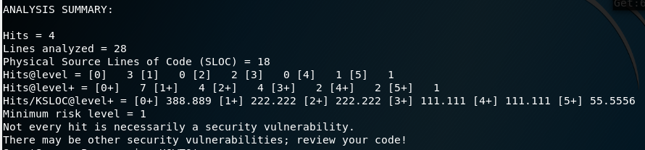
Options : Output Format (Cont. 6/7)
Omit timing information. This is useful for regression tests of ﬂawﬁnder itself, so that the output doesn’t vary depending on how long the analysis takes.
root@kali:~/softwareTesting# flawfinder --omittime vuln.c|less
Siddiqre Reza Khan, 3846259
Notes:
this is shown after the line number by adding a colon and the column number in the line (the ﬁrst character in a line is column number 1). This is useful for editors that can jump to speciﬁc columns, or for integrating with other tools (such as those to further ﬁlter out false positives).
This is the recommended format for sending to other tools for processing. It will always generate a header row, followed by 0 or more data rows (one data rowfor each hit).
The headers are mostly self-explanatory."File" is the ﬁlename, "Line" is the line number,"Column" is the column (starting from 1), "Level" is the risk level (0-5, 5 is riskiest), "Category" is the general ﬂawﬁnder category,"Name" is the name of the triggering rule, "Warning" is text explaining why it is a hit (ﬁnding), "Suggestion" is text suggesting how it might be ﬁxed, "Note" is other explanatory notes, "CWEs" is the list of one or more CWEs, "Context" is the source code line triggering the hit, and "Fingerprint" is the SHA-256 hash of the context once its leading and trailing whitespace have been removed (the ﬁngerprint may help detect and eliminate later duplications). If you use Python3, the hash is of the context when encoded as UTF-8.

Slide 32
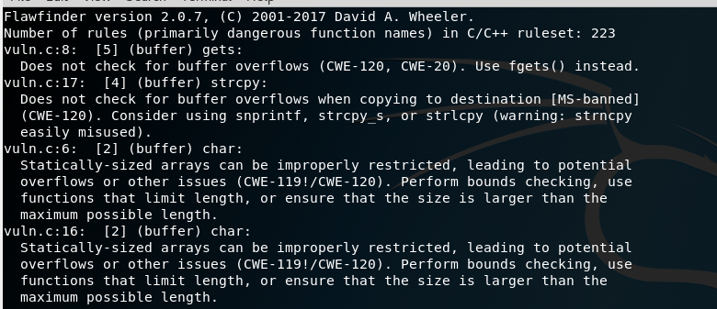
Options : Output Format (Cont. 7/7)
Don’t display status information (i.e., which ﬁles are being examined) while the analysis is going on.
root@kali:~/softwareTesting# flawfinder -Q vuln.c|less
Siddiqre Reza Khan, 3846259
Notes:
this is shown after the line number by adding a colon and the column number in the line (the ﬁrst character in a line is column number 1). This is useful for editors that can jump to speciﬁc columns, or for integrating with other tools (such as those to further ﬁlter out false positives).
This is the recommended format for sending to other tools for processing. It will always generate a header row, followed by 0 or more data rows (one data rowfor each hit).
The headers are mostly self-explanatory."File" is the ﬁlename, "Line" is the line number,"Column" is the column (starting from 1), "Level" is the risk level (0-5, 5 is riskiest), "Category" is the general ﬂawﬁnder category,"Name" is the name of the triggering rule, "Warning" is text explaining why it is a hit (ﬁnding), "Suggestion" is text suggesting how it might be ﬁxed, "Note" is other explanatory notes, "CWEs" is the list of one or more CWEs, "Context" is the source code line triggering the hit, and "Fingerprint" is the SHA-256 hash of the context once its leading and trailing whitespace have been removed (the ﬁngerprint may help detect and eliminate later duplications). If you use Python3, the hash is of the context when encoded as UTF-8.

Slide 33
Options : Hitlist Management (Cont. 1/3)
−−savehitlist=F
Save all resulting hits (the "hitlist") to F.
−−loadhitlist=F
Load the hitlist from F instead of analyzing source programs.
Warning: Do not load hitlists from untrusted sources (for security reasons).
Siddiqre Reza Khan, 3846259

Slide 34
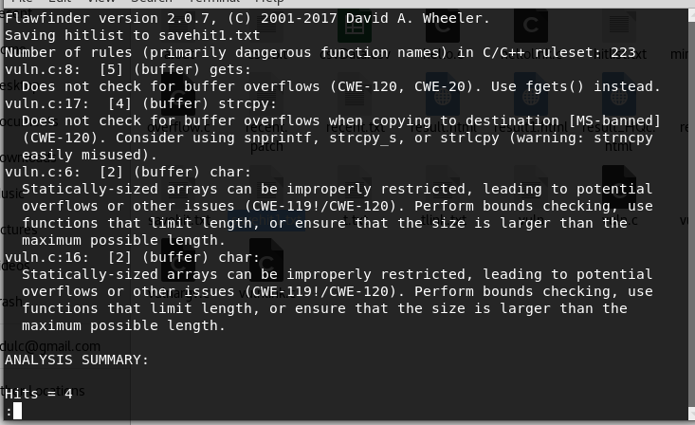
Options : Hitlist Management (Cont. 2/3)
Save all resulting hits (the "hitlist") to F
root@kali:~/softwareTesting# flawfinder -Q --savehitlist savehit1.txt vuln.c|less
Siddiqre Reza Khan, 3846259

Slide 35
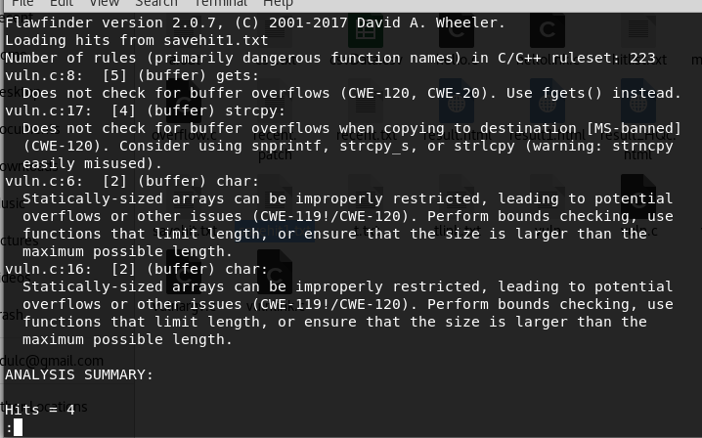
Options : Hitlist Management (Cont. 1/3)
Load the hitlist from F instead of analyzing source programs
root@kali:~/softwareTesting# flawfinder -Q --loadhitlist savehit1.txt|less
Siddiqre Reza Khan, 3846259

Slide 36
COMMON WEAKNESS ENUMERATION (CWE)
It is a community-developed list of common software security weaknesses that can occur in software’s architecture, design, code or implementation that can lead to exploitable security vulnerabilities
Flawﬁnder is ofﬁcially CWE-Compatible and can report on the CWEs
Example:
CWE-20: Improper Input Validation
CWE-119: Improper Restriction of Operations within the Bounds of a Memory Buffer (a parent of CWE-120*, so this is shown as CWE-119!/CWE-120)
CWE-120: Buffer Copywithout Checking Size of Input (‘‘Classic Buffer Overﬂow’’)*
CWE-134: Uncontrolled Format String*
CWE-190: Integer Overﬂow or Wraparound*
CWE-362: Concurrent Execution using Shared Resource with Improper Synchronization (‘‘Race Condition’’)
CWE-676: Use of Potentially Dangerous Function*
Siddiqre Reza Khan, 3846259
Notes:
se·man·tics
[səˈman(t)iks]
NOUN
logical semantics (noun) · lexical semantics (noun)
the branch of linguistics and logic concerned with meaning. There are a number of branches and subbranches of semantics, including formal semantics, which studies the logical aspects of meaning, such as sense, reference, implication, and logical form, lexical semantics, which studies word meanings and word relations, and conceptual semantics, which studies the cognitive structure of meaning.

Slide 37
Conclusion
Static analysis Source code scanning tool to find the most common security problems with C/C++ programs
Easy to understand
Looking for C function’s token(simple lexical tokenization) matches with tool’s database
Searching for potential vulnerabilities or estimating the level of risk
Report formats can customize
The application has the ability to take input values as command line arguments
Doesn't do data flow or control flow or data types analysis
Produce many false positives for vulnerabilities
Fail to report many vulnerabilities
Siddiqre Reza Khan, 3846259
Notes:
se·man·tics
[səˈman(t)iks]
NOUN
logical semantics (noun) · lexical semantics (noun)
the branch of linguistics and logic concerned with meaning. There are a number of branches and subbranches of semantics, including formal semantics, which studies the logical aspects of meaning, such as sense, reference, implication, and logical form, lexical semantics, which studies word meanings and word relations, and conceptual semantics, which studies the cognitive structure of meaning.

Slide 38
Tool Demonstration
Siddiqre Reza Khan, 3846259

Slide 39
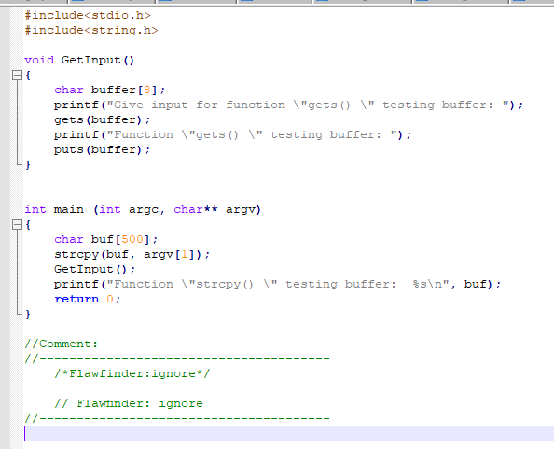
C/C++ Code : For Tool Demonstration
Siddiqre Reza Khan, 3846259

Slide 40
Options : Demonstration (Cont. 1/2)
flawfinder -m 4 vuln.c | less
Examine ﬁle only report vulnerabilities level 4 and up
flawfinder -I vuln.c| less
Examine ﬁle to report the functions that take inputs
flawfinder -n vuln.c | less
Examine ﬁle to report including even the hits marked for ignoring in the code comments
flawfinder --csv vuln.c >csvData.csv
Examine file to report all hits in CSV format
flawfinder -QD vuln.c | less
Examine file to report only the actual results (removing the header and footer of the output).
Siddiqre Reza Khan, 3846259

Slide 41
Options : Demonstration (Cont. 2/2)
flawfinder -QDSC vuln.c|less
Examine file to report only the actual results
flawfinder -QHc vuln.c>result.html
Examine the ﬁle and produce HTML formatted results
flawfinder -Q --savehitlist savehit.txt vuln.c|less
Examine ﬁle save the resulting hitlist in savehit.txt file
flawfinder --loadhitlist savehit.txt vuln.c|less
Examine ﬁle and show hits that were already in the ﬁle savehit.txt
flawfinder --regex "CWE-119|CWE-120" vuln.c | less
Examine file, but only report hits where CWE-119 or CWE-120 apply.
Siddiqre Reza Khan, 3846259

Slide 42
Bibliography
[1] David A. Wheeler, “Secure Programming HOWTO”, v3.72 Edition, 2015.
[2]Online: https://dwheeler.com/flawfinder/, “Flawfinder”, accessed on: 02.11.2018
[3]Online:https://www.debian.org/security/audit/examples/flawfinder, “Automated Audit Example: flawfinder”, accessed on: 02.11.2018
[4]Online: https://dwheeler.com/secure-class/index.html, “Secure Software Design and Programming: Class Materials by David A. Wheeler”, accessed on: 02.11.2018
[5]Online:http://manpages.ubuntu.com/manpages/bionic/man1/flawfinder.1.html, “flawfinder - lexically find potential security flaws ("hits") in source code ”, accessed on: 02.11.2018
[6]Online: https://dwheeler.com/flawfinder/flawfinder.pdf, ”Documentation - Flawﬁnder ”, accessed on: 02.11.2018
[7]Online: Daniel Persson, Dejan Baca, Software Security Analysis - Managing source code audit, https://www.diva-portal.org/smash/get/diva2:830925/FULLTEXT01.pdf, accessed on: 19.12.2018
[8]Online: http://cwe.mitre.org/top25/ , “2011 CWE/SANS Top 25 Most Dangerous Software Errors” , accessed on: 07.01.2019
[9] Online: https://www.sans.org/reading-room/whitepapers/securecode/secure-software-development-code-analysis-tools-389, “Secure Software Development and Code Analysis Tools”, accessed on: 19.01.2019
Siddiqre Reza Khan, 3846259

Slide 43
Questions?
Siddiqre Reza Khan, 3846259

